Slide 1
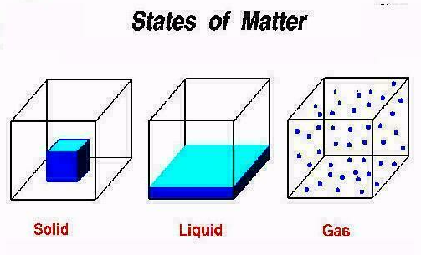
Part one principles of chemical reactions
(Thermodynamics and Kinetics of Chemical Reactions)
Chapter one GAS
Aggregate

Slide 3
等离子态Plasma state ——电离化的气体ionized gases(正负离子组成的气体)
超固态Ultra solid state —— 电子和原子核之间no space
中子态Neutron state —— 强烈的挤压下，proton + electron into neutron

Slide 4
Chapter One GAS
Part 1 Properties of gases (be omitted略)
Part 2 Law of an ideal gas
Part 3 Mixed gases
Part 4 Law of partial pressure
要求：
1. 掌握理想气体状态方程的公式和计算；
2. 掌握混合气体分压定律和计算。

Slide 5




Volcanic gases
Where greenhouse gases come from

Slide 6

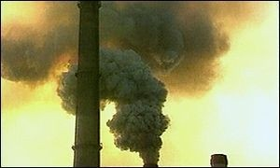
gases of balloons
Emission of gases

Slide 7
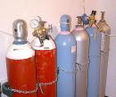
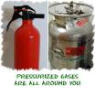

Pressurized gases are all around you
—实验室
Scuba diving
—Self-Contained Underwater Breathing Apparatus

Slide 8
Part 2 Law of an ideal gas
What is an ideal gase?
In brief, an ideal gases has no volume & attractions from each other(与是什么气体无关) .
In detail, an ideal gas or perfect gas is a hypothetical gas consisting of identical particles of negligible volume, with no inter-molecular forces. Additionally, the constituent atoms or molecules undergo perfectly elastic collisions wih the walls of the container.
Applied conditions —— at the higher temperatures or at the lower pressures .

Slide 9
Law of ideal gases is also called equation of state of ideal gases:
注：一定要注意pV单位的组合，熟记三套单位组合（最常用的是kPa·L）！ 这里的pV单位是 焦耳J not kJ！

Slide 11
说明两点：
一、单位
理想气体摩尔体积：at 0℃, 1atm (标态下STP) , the volume 1mol ideal gas is 22.4 litre (代入公式可知on the other conditions, it is not！)
——也就是说，22.4升不能乱用！
注：标准状态/标态:
（STP—— 0℃( 273.15K)、101.325 kPa or 1.01×10⁵Pa)
理想气体的标态 ≠热力学标态 （p^{ϴ}=100kPa）！
1 atm = 760 mmHg = 101.325 kPa

Slide 12
二、公式变化
(1)
pV = nRT
当n、T不变时，不同状态 i的pV
p_{i}V_{i} = C (常数)
(2)
m
m
n =
ρ =
M
V
mRT
pV =
pM = ρRT
M

Slide 13
容易得到---阿佛加德罗定律：同温同压下，相同体积的任何气体含有相同的分子数。
注：1、计算最好采用分状态的方式来计算，下面会举例说明（后面热力学第一定律中的做功的计算要用到——
2、298K or 298.15K，原则上，大数据用前者，小数据用后者；
3、压力应该用小写p表示
W= － p⊿V = － ⊿nRT

Slide 14
例 在实验室中，由金属钠与氢气在较高温度(﹥300℃)下制取氢化钠(NaH)时，反应前必须将装置用无水无氧的氮气置换。氮气是由氮气钢瓶提供的，其容积为50.0L，温度为25℃、压力为15.2MPa。
(1)计算钢瓶中氮气的物质的量n(N₂)和质量m(N₂)；
(2)若将实验装置用氮气置换了五次后，钢瓶压力下降至13.8 MPa。计算在25℃、0.100MPa下，平均每次耗用氮气的体积。
已知：（1）V₁=50.0L, p₁=15.2MPa, T₁=273+25=298K
求: n(N₂)、m(N₂)
（2）V₂=50.0L, p₂=13.8MPa, T₂=273+25=298K, p₃=0.100MPa
求: 1/5V(N₂)

Slide 15
状态1：
T=298K、
p=15.2 MPa、
V=50L、
n
状态2：
T=298K、
p₂=15.2 – 13.8 = 1.4 MPa、
V₂=50L、
n₂
↘
状态3：
T=298K、
p₃=0.1 MPa、
V₃=? L、
n₂

Slide 16
解：（1）可以直接套公式： pV = n RT
n = m/M
（2）因为同温，可用公式：p₂V₂ = p₃V₃
设p₂ = 15.2 – 13.8 = 1.4 MPa; V₂=50.0L
p₃ = 0.100MPa; V₃ = V(N₂)
所以， 1/5V(N₂)= 1.4×50.0/(5× 0.100)
= 140 (L)
或（2）根据物质的量不变（实际上也是p₂V₂ = p₃V₃）：
n₂ = (p₂V₂)/RT 代入下式：
V₃= n₂RT/p₃
=[(15.2-13.8)×50]/0.1
= 700 L
1/5V(N₂)= 140L

Slide 17
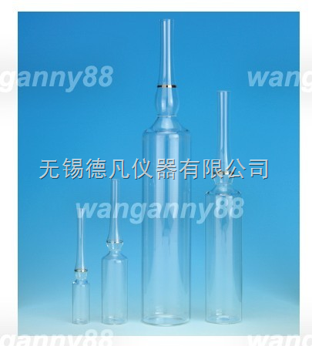
例 常温常压下（298K、101.325kPa）石英安瓶被整体加热到800K时急速用火焰封闭，求封闭后瓶内的气体在常温下的压力多大？
分析：关键点在于，加热到800K时急速用火焰封闭——封闭前与外界相通，所以压力等于常压

Slide 19
Part 3 Mixed gases
How do we deal with gases composed of a mixture of two or more different substances?
Mixed gases are also ideal gases, therefore, they follow the laws of ideal gases.
Part 4 Law of partial pressure
1、 partial pessure (p_{i})
the pressure exerted by an individual gas in a mixture of gases at the same T、V.
p_{i}V = n_{i}RT

Slide 20
二、 标准平衡常数K^{Θ}(standard equilibrium constant )
对于一般反应，

Slide 21
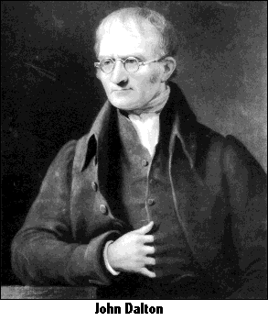
2、 Dalton's Law of Partial Pressures
John Dalton
(1766-1844)
— ( familiar with Dalton's atomic theory)
The total pressure (P_{t} ) of a mixture of gases equals the sum of the pressures (P₁,P₂,P₃, …) that each would exert if it were present alone.
p_{t} = p₁ + p₂ + p₃ + ...

Slide 22


At constant temperature and volume, the total pressure of a gas sample is determined by the total number of moles of gas present .
The value ( n₁ / n_{t} ) is termed the mole fraction (X) of the component gas.

Slide 23
Example 1
A gaseous mixture made from 10g of oxygen and 10g of methane is placed in a 10L vessel at 0°C.
What is the partial pressure of each gas, and what is the total pressure in the vessel?
已知：V=10 L, T=273K，m(O₂)=10g, m(CH₄)=10g
求: p_{O2}、 p_{CH4} and p_{t}

Slide 24
Example 2：
A sample of hydrogen gas is collected over water at 14.0 ºC. The pressure of the resultant mixture is 101.6 kPa (V=1.0L) . What are the pressure and the mol number of the dry hydrogen at the same temperature?
已知： p_{t} = 101.6kPa, T=273+14=287K, V=1.0L
求: p_{H2}、 n(H₂)

Slide 25
Table-----Vapor Pressure of Water
T(°c) | P (kPa) |  | T(°c) | P (kPa) |  | T(°c) | P (kPa)
0 | 0.6 |  | 20 | 2.3 |  | 30 | 4.2
3 | 0.8 |  | 21 | 2.5 |  | 32 | 4.8
5 | 0.9 |  | 22 | 2.6 |  | 35 | 5.6
8 | 1.1 |  | 23 | 2.8 |  | 40 | 7.4
10 | 1.2 |  | 24 | 3.0 |  | 50 | 12.3
12 | 1.4 |  | 25 | 3.2 |  | 60 | 19.9
14 | 1.6 |  | 26 | 3.4 |  | 70 | 31.2
16 | 1.8 |  | 27 | 3.6 |  | 80 | 47.3
18 | 2.1 |  | 28 | 3.8 |  | 90 | 70.1
19 | 2.2 |  | 29 | 4.0 |  | 100 | 101.3

Slide 26
Example 3：
在298.15K，1.47MPa下把氨气通入容积为1.00L的刚性壁密闭容器中，在623.15K下用催化剂使部分氨气分解成氮气和氢气，这时测得总压为5MPa，求氨的解离度、各组分气体的摩尔分数和分压。
已知：T₁=298.15K， T₂=623.15K， V =1.00L
p₁(NH₃) = 1.47MPa， p_{t} = 5MPa
求： α(NH₃);
χ(NH₃)， χ(H₂)， χ(N₂);
p (NH₃)， p (H₂)， p(N₂)

Slide 27
解： 根据pV=nRT，在没有反应前（温度上升），
NH₃ 的压力为p₂可以用公式p₁/ p₂=T₁/T₂计算为：
1.47/p₂= 298.15/623.15 p₂= 3.07 MPa
在V、T一定时，化学反应方程式可用p代替n来计算
2NH₃ → N₂ + 3H₂
3.07MPa 0 0
3.07-2x x 3x
3.07-2x + x + 3x = 5
x = 0.96 Mpa
或 也可以用物质的量代入计算:

Slide 28
1.47×1000×1 = n₁×8.314×298.15
n₁= 0.593 mol
5×1000×1 = n₂×8.314×623.15
n₂= 0.975 mol
2NH₃ → N₂ + 3H₂
0.593 0 0
0.593-2x x 3x
0.593-2x + x + 3x = 0.975
x = 0.186 mol
[p₁/ p₂ = n₁T₁/n₂T₂
1.47/5 = (298.15/623.15)(1/(1+x))
x = 0.63]

Slide 29
α(NH₃) = 2×0.96/3.07 = 62.76%
χ(NH₃) = (3.07-2×0.96)/5 = 0.23
χ(H₂) = 3×0.96/5 = 0.58
χ(N₂) = 0.96)/5 = 0.19
根据p_{i} = χ_{i}p_{t}
p(NH₃) = 0.23×5 = 1.15 MPa
p (H₂) = 0.58×5 = 2.90 MPa
p(N₂) = 0.19×5 = 0.95 MPa

Slide 30
Quenstions in real life：
1. A balloon filled with helium weighs much less than an identical balloon filled with air.
2. Why is wet air less dense than dry air at the same temperature?
3. Deep sea fish die when brought to the surface.

Slide 31
Note: (The pressure decreases as the fish are brought to the surface, so the volume of gases in their bodies increases, and pops bladders, cells, and membranes). —— comparing it with cosmetic surgery(including face-lift, breast implant… )
作业： P₂₄ --- 2、4、6、7

Slide 32
补充：
分体积 —— 某组分气体B与混合气体相同压力时单独所占有的体积(实际上，温度也相同)。公式有

